Slide 1

By : Gargi rane

Slide 2


Slide 3


Slide 4
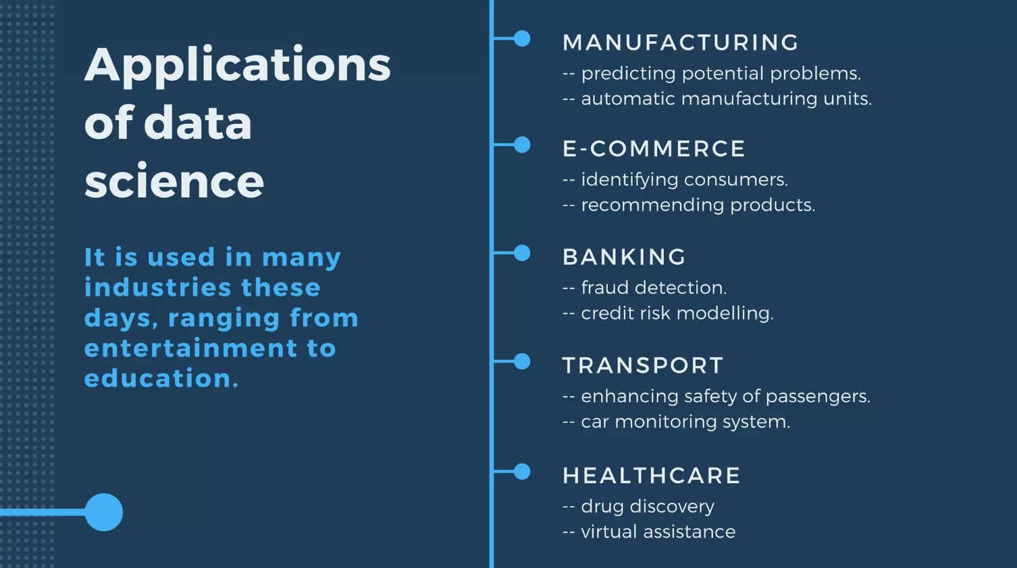

Slide 5


Slide 6
Thank you!
Thank you!

